Slide 1

strategic Resilience Post-Disaster: Leveraging Code Enforcement & Mitigation
Maximizing Federal Resources for Long-Term Recovery
Melissa Boudrye, Resilience Branch Chief,
California Governor’s Office of Emergency Services (cal oes)

Slide 2
Setting the Stage
Disasters = Opportunities to reinforce community resilience
Recovery decisions in the first 6-12 months shape community resilience for decades
Key question: Are we just rebuilding, or building back stronger?

Slide 3
Post-Disaster Mitigation-Resiliency Framework
Immediate Post-Disaster Code Enforcement
Category I (PA) &
5% Code Enforcement (HMGP)
Strategic, Long-Term Resilient Recovery
Maximizing 406 (PA) & 404 (HMGP)
Strategic Resilience

Slide 4
Laying the Foundation: Key FEMA Funding Programs
Public Assistance (PA)
  Category A: Debris Removal
  Category B: Emergency Protective Measures
  Category C Roads & Bridges
  Category D Water Control Facilities
  Category E Public Buildings & Equipment
  Category F Utilities
  Category G Parks, Recreational, & Other Facilities
  Category I Code Enforcement / Building Inspections
Public Assistance Mitigation (406)
Hazard Mitigation Assistance-Hazard Mitigation Grant Program (HMGP-404)
  5% Codes & Standards
  5% Initiative (Innovative Mitigation Solutions)
  Advanced Assistance (Up to 25%)
  Planning Grants (Up to 7%)
  Management Costs (Up to 15%)
  HMGP Projects
Notes:
On PA and HMGP - hit home that PA is a reimbursement program and that HMGP is capped. Even in a disaster as large as LA, the capping of Building Code activities means that we really can't fully support the work of each local gov't entity with a stake in the permitting/rebuilding process

Slide 5
 | Eligible Applicants | Cost Share | Eligible Activities
PA (Cat C-I) | Public Entities: State, local, tribal, territorial (SLTT) governments Certain private nonprofits (critical facilities, essential services) | Standard: 75% federal / 25% non-federal Can increase to 90/10 in major disasters at presidential discretion | Repair/replacement of roads, bridges, water facilities, utilities, public buildings, parks, equipment (Cat I) Surge staffing for inspections; overtime/backfill; temporary office/equipment; IT/permitting systems
PA Mitigation (406) | Same as PA (SLTT + eligible PNPs) | 75% Federal Share 25% Non-Federal Share | Appendix J; Mitigation added to damaged facilities (e.g., seismic bracing, floodproofing, fire-resistant rebuilds)
HMGP (404) | SLTT governments (often sub-applicants via state); Eligible PNPs via sponsors Private sector entities can be pass-through subrecipients if the primary applicant is a public entity | 75% Federal Share 25% Non-Federal Share | Standalone mitigation projects, not tied to damages from a disaster (buyouts, safe rooms, wildfire hardening, undergrounding utilities); 5% Codes & Standards = post-disaster code enforcement 5% innovative pilots Local Hazard Mitigation Plans Planning Related Projects Advanced Assistance/Scoping Projects

Slide 6
What’s Eligible under Category I?
Detailed eligible activities lists (now spelled out) across four buckets:
*** Labor cost rules. For Category I, only overtime is eligible for budgeted staff; straight-time and overtime are eligible for unbudgeted staff.
Ineligible activities clarified.
  No funding for non-disaster-related code enforcement;
  No adopting/updating codes, floodplain ordinances, zoning, or land-use plans;
  Category I cannot be used as an alternate project and cannot include a 406 HMP component.
Building code administration (permit intake/review, staffing, contractor support, public/staff training, plan review systems, monitoring for unpermitted work, etc.); | Code enforcement (inspections, corrective action, condemnations, elevation certs, violation abatement support); | Floodplain ordinance administration & enforcement (permits, inspections, public outreach, enforcement actions); | Substantial damage determinations (field surveys, SDE data entry, owner notices, compliance inspections, appeals).

Slide 7
What’s new in PA Policy?
Disaster Recovery Reform Act (DRRA) §1206 authorizes FEMA PA funding for building code and floodplain management administration and enforcement (BCFMAE) after a major disaster—i.e., the work your code and floodplain teams do to keep post-disaster rebuilding safe and compliant. PAPPG v5 folds this into PA Category I and formalizes eligibility, limits, and documentation.
What’s new/clarified in PAPPG v5 (effective for disasters declared on/after Jan 6, 2025)
  Category I codified in the Guide (previously covered under Category B) with a dedicated chapter and project “grouping.” FEMA explicitly places BCFMAE activities in Category I and says to group them together.
  Firm 180-day eligibility window. Costs are eligible from the incident start and up to 180 days after PA permanent work is authorized; no extensions beyond 180 days.
  Good-standing in NFIP required. Communities suspended/sanctioned under NFIP are ineligible for Category I.
  Where/what work qualifies. Activities must be within the declared designated areas, within the applicant’s jurisdiction, and related to repair/replace/retrofit/relocate of disaster-damaged facilities (public, private, residential).

Slide 8
What’s Eligible under HMGP 5% Codes & Standards
Eligible Activities:
Code Evaluation & Enhancement Assess existing building codes, zoning, subdivision, and floodplain ordinances. Update codes to align with latest consensus editions or stronger standards.
Development & Training Develop hazard-resistant codes and ordinances. Train and certify inspectors, plan reviewers, and code officials. Deploy e-permitting, remote inspection, and enforcement technology.
Equipment & Materials Purchase code manuals, subscriptions, inspection software, and necessary equipment.
Post-Disaster Code Enforcement Surge permitting, inspections, and plan review capacity. Conduct substantial damage determinations. Provide technical assistance to property owners for compliant repairs.
5% of HMGP funds to support adoption, enforcement, and enhancement of hazard-resistant building codes and land-use standards. Designed to accelerate resilient rebuilding and community capacity after a Presidential disaster declaration. Separate from the 5% Initiative set-aside but can be used in conjunction.
Ineligible Activities
Weakening codes or adopting standards below consensus codes.
Routine, baseline staffing costs unrelated to the disaster.
Activities already funded by other federal programs (e.g., overlapping PA Cat I).
Physical construction/demolition not tied to capability/capacity.

Slide 9
the Post Disaster Code Enforcement Timeline
Date of Incident
Date of FEMA Declaration (Permanent Work Inclusion PA Category C-I)
180-Day Deadline for Category I Projects
15-Month FEMA HMGP Application Deadline
30-Day Estimate for HMGP is Released by FEMA
180-day countdown for Category I begins
Documented eligible Category I work can be reimbursed beginning on this date
5% Codes & Standards Subapplications can be submitted to FEMA as early as this date
All Category I projects must be completed by this date no work will be reimbursed under Category I after this date
All HMGP subapplications including 5% Codes & Standards projects must be submitted to FEMA by this date(via your SLTT applicant)
48-Month Period of Performance (POP) for HMGP 5% Codes & Standards Projects

Slide 10
Code Enforcement as Mitigation: HMGP 5% Codes & Standards
Key Actions for Emergency Managers
Pre-Disaster Prep
  Include post-disaster code enforcement in your Hazard Mitigation Plan.
  Build a “ready-to-submit” HMGP project application template.
  Identify longer-term staffing, training, and IT needs.
Post-Disaster Transition
  Shift from Cat I (surge staffing) to HMGP 5% (sustained staffing & system upgrades).
  Use HMGP 5% to:
    Train inspectors on resilient codes.
    Fund digital permitting or mobile inspection tools.
    Support public education campaigns on safe rebuilding.
Lessons Learned Communities that plan HMGP projects before disasters capture more funding. Don’t duplicate Cat I activities—frame HMGP as “sustaining + improving.” Pair with HMGP Planning (7%) for code updates in your LHMPs if needed. Leverage 5% Initiative funding to maximize full 10% of HMGP funding on code enforcement activities to maximize early funding wins post-disaster
Notes:
Think of HMGP 5% as the bridge that keeps enforcement strong after Cat I ends. If you don’t plan ahead, there’s often a funding gap right when communities are still rebuilding.
PA Category I → funds immediate, short-term enforcement (first 180 days).
HMGP 5% Codes & Standards → funds longer-term, capacity-building enforcement initiatives that continue after PA funding ends.

Slide 11
Code Enforcement as Mitigation: PA Category I
Key Actions for Emergency Managers
Pre-Disaster Prep
  Document baseline staffing/inspection capacity.
  Pre-identify contracts & mutual aid agreements.
  Build tracking systems (timesheets, permit logs, GPS for inspections).
When Disaster Hits
  Activate surge inspectors (Category I covers overtime/backfill staff support).
  Deploy temporary IT/permitting systems to manage volume.
  Tie all inspections to disaster-damaged structures only.
Lessons Learned Missing baseline data = delayed or denied reimbursement. Many communities underutilize Cat I by not tracking inspections in detail. Must wrap work within 180 days — plan staffing accordingly.
Notes:
Category I is about buying time and bandwidth. Use it to handle the initial surge, but start planning the handoff to longer-term funding on day one.

Slide 12
Strategic Code Enforcement for Resilient Recovery
Prepare Early
Act Fast
Transition Strategically
Integrate
Document baseline staffing, contracts, and tracking systems before disaster.
Deploy Category I for surge inspections as soon as disaster hits.
Use HMGP 5% to sustain & expand capacity once Cat I ends.
Align Cat I + HMGP 5% Codes & Standards to maximize post disaster code enforcement.
Lessons Learned Missing baseline = lost reimbursement. Communities that pre-plan HMGP projects capture more funds. Code enforcement is not just compliance—it’s strategic mitigation.

Slide 13
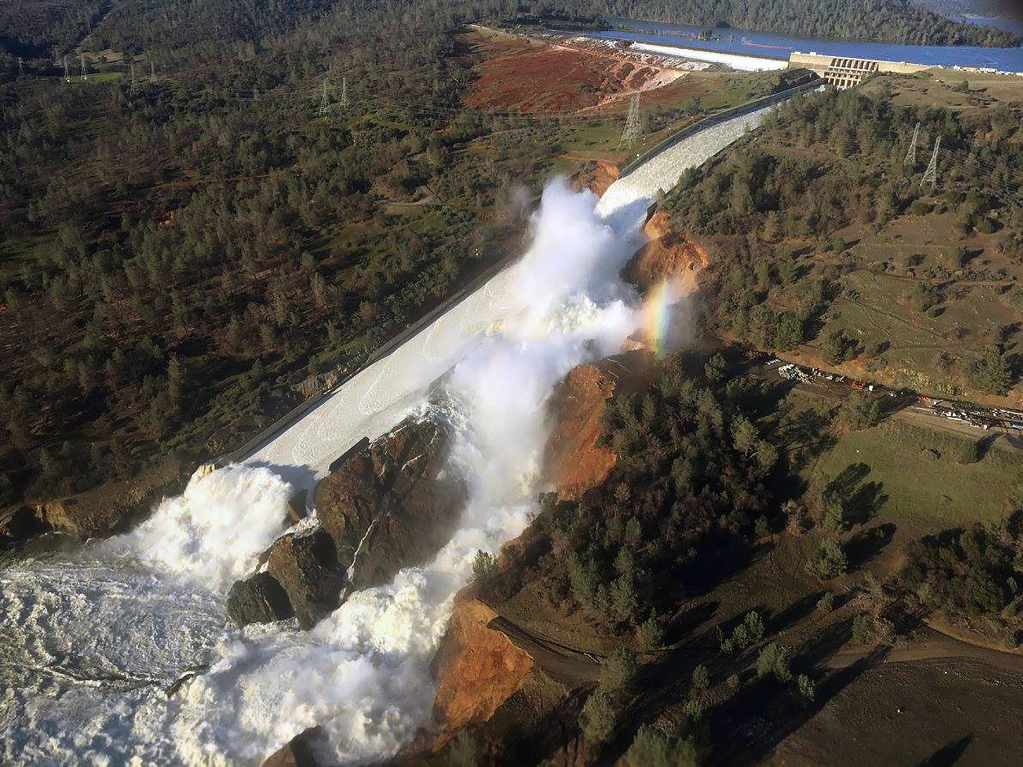
Strategic Recovery
Mitigation
Disaster Funding
Resilience
Notes:
Quick review of some of the benefits of the State Hazard Mitigation Plan
Mitigation
Reduce potential casualties, damage, and physical, social, economic, and environmental disruption from natural and human-caused disasters
Save $6 for every $1 spent
Disaster funding
This mitigation plan is the key to funding mitigation actions either before or after a bad thing happens
A standard, approved hazard mitigation plan is a condition of receiving non-emergency Stafford Act assistance such as:
Public Assistance (PA)
Fire Management Assistance Grants (FMAG)
Hazard Mitigation Assistance (HMA) Grants
Rehabilitation of High Hazard Potential Dam (HHPD) Grants
California's enhanced plan makes the state eligible for increased funds under the Hazard Mitigation Grant Program
Resilience
Californians better able to recover from disasters
Reduced costs associated with disaster response and recovery
Improved relationships at state and local levels

Slide 14
Long-Term Resilient Recovery
Community Resilience
Mitigation: Preventing future disasters or minimizing their effects
Preparedness: Preparing communities to handle a disaster or emergency
Response: Stabilizing an incident and responding safely to an emergency
Recovery: Repairing damages caused by a disaster or incident
Recovery without strategy is simply rebuilding. But with foresight and strategic alignment, it’s an opportunity to leap forward in resilience.
There is a perception that Mitigation occurs long after Recovery is complete, when in reality it is an integrated process.

Slide 15
Funding Alignment Timeline
Day 0-Disaster Declaration
PA: 30 Days-Request for Public Assistance (RPA)
PA: Recovery Scoping Meetings (RSM) Scheduled
PA: Damage Inventory Lists Due +60 Days from RSM
PA: +60 Days to develop Project Worksheets (PW)
PA: 18 Month POP from Declaration for Permanent Work Projects
HMGP: 15 Months HMGP Subapplications due to FEMA
Project by project deadlines can be extended up to 30 additional months
HMGP: 48-Month POP for all projects
HMGP: 30 Estimate Released by FEMA

Slide 16
Integrating 406 & 404
PA Mitigation 406
Tied to eligible repairs of disaster-damaged infrastructure
HMGP 404
Funds hardening of non-damaged infrastructure to mitigate against impacts of future disasters
Pros:
Cons:
No Funding Cap
Quicker disbursement of funds
Limited to hardening disaster-related repairs
Innovative application of funding for mitigation and resiliency projects
Limited to HMGP funding allocation (15-20% of federal recovery investment of IA & PA 12-Month Lock-In)
Lengthy grant application review process depending on project complexity
Cons:
You can draft HMGP projects prior to a disaster
Pros:
Timeline to capture damages and develop PWs doesn’t align with 404 deadlines
Longer POP
Notes:
While FEMA doesn’t mix 406 & 404 funding within the same project leveraging the two programs to support a more cohesive and holistic recovery is an effective way to maximize your federal investment.
406 Mitigation: tied to repairs.
404 HMGP: broader projects.
Overlap: aligned planning = bigger impact, less duplication.
Speaker Note:
When these two programs work in silos, money is left on the table. But aligned together, they reinforce each other — one strengthens what was lost, the other invests in what could be.

Slide 17

Maximizing Federal Investments
The biggest takeaway: we can’t treat funding streams separately. They’re puzzle pieces — and it’s our job to fit them together.

Slide 18
Maximizing Federal Investments
Key Actions for Emergency Managers
Pre-Disaster Prep
  Document eligible structures and infrastructure systems
  Know who your eligible stakeholders are within your community and build relationships with them prior to disasters
  Identify Mitigation Actions or opportunities in your Local Hazard Mitigation Plan
    Build out draft HMGP subapplications based on potential priority projects
  Complete pre-work for priority HMGP projects: scoping/design/EHP review
  Pre-identify contracts & mutual aid agreements.
  Develop tracking systems, documentation templates, internal guidance & SOPs
When Disaster Hits (post-response & stabilization)
  Host Kick-Off Meeting with all relevant recovery stakeholders once you’ve captured your damage inventory list
  Determine project priorities for PA 406 & HMGP 404
    Be intentional with your HMGP Notice of Funding Opportunity to highlight the priority projects your community is looking to fund, and socialize those priorities early
  Identify Contractor/Consultant Support early for pre-award activities (HMGP-404) and A&E activities (PA-406)

Slide 19
Lessons Learned: 406 PA & 404 HMGP Funding Alignment
Identify community leadership priorities early in the process to ensure the recovery strategy maintains alignment to the community’s vision for a resilient recovery
Don’t overcomplicate your recovery strategy—identify what needs to be fixed (PA), what you would like to make stronger (406), and what wasn’t damaged that you’d like to mitigate (404)
Ensure that priorities and the strategy are communicated consistently across the recovery and that buy-in is incorporated across all programs
Organize your recovery team so that there is representation from all stakeholders with key decision-makers to expedite concurrence
  Align targeted working groups, strike teams, task forces based on project-specific requirements, but always circle back to core recovery team to ensure progress is communicated and any issues can be managed effectively
Determine opportunities for PA 406 early to begin development/incorporation into the PA projects
Build out HMGP 404 projects/templates in advance of a disaster so that they can be submitted once the initial 30-day HMGP Cost-Estimate is released
Notes:
also overall, reminding folks that in this federal climate, integrating 406 is gonna be a battle - get your FCO on board immediately
And no one knows if we'll ever get 404 - so do 406 and Category I!

Slide 20

Call to Action
Don’t wait until the disaster to prepare for recovery and resilience opportunities
Use Category I + HMGP 5% to scale code enforcement.
Align PA 406 + HMGP 404 from day one and get leadership buy-in early!

Slide 21
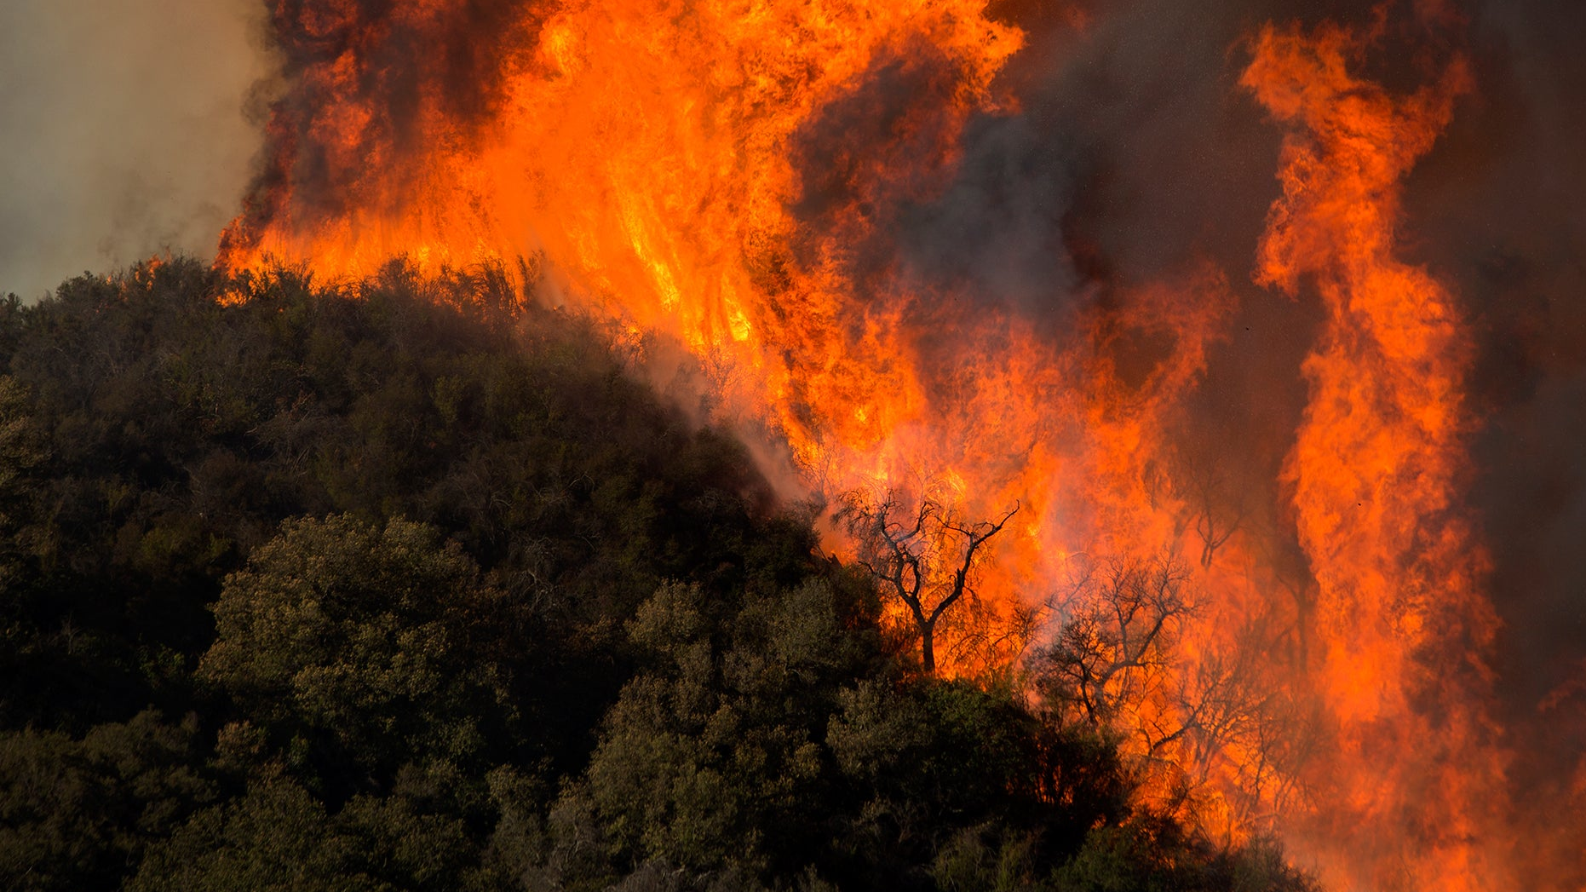
Questions?
This Photo by Unknown Author is licensed under CC BY
Notes:
While you can’t anticipate what damages your community might suffer as a result of a disaster there are actions your community can take in advance of a disaster to ensure you are maximizing the federal post-disaster programs.
What systems do we need to align 406 & 404?
What can your communities do to be better prepared to maximize post-disaster federal funding?

